Slide 1

City of Los Angeles
Pre-proposal Conference
RFP # 222183
After-Action Report on the City of Los Angeles’s Preparation for and Response to the Windstorm and Fires of January 2025
July 8, 2025

Slide 2
Introductions
Louisa Lund, Analyst in the Office of the Chief Legislative Analyst (CLA)
Kimberly Tejada, Analyst in the Office of the Chief Legislative Analyst (CLA)
Please note this session is being recorded.
Please email louisa.lund@lacity.org if you’d like your name to be added to the list of attendees of this conference.
01
02
03
03
04
03

Slide 3
Agenda
Introduction to the Pre-proposal Conference
RFP Context
RFP Scope
Budget
Proposed Timeline
How to Propose
How to Submit Questions
Questions
01
02
03
03
04
03

Slide 4
Introduction to the Pre-proposal Conference
For questions, please enter your questions using the “chat” function, and we’ll address them at the end–or if you have an urgent point of clarification, use the “raise hand” function, and we’ll try to address that right away.
The session is being recorded. The recording and the slides will be posted to RAMPLA. We will also post a written summary of questions and answers.
In case of any conflict between the discussion today and written Q&A posted to RAMPLA, written Q&A posted to RAMPLA should govern.
01
02
03
03
04
03

Slide 5
RFP Context
January 2025 Los Angeles Windstorm and Fires. Note we include “Windstorm” because we view the Windstorm and the City’s response to the Windstorm that began prior to the Fires themselves as part of the scope of the After Action Report.
City Council directed the Office of the Chief Legislative Analyst (CLA) to conduct a competitive procurement for an After Action Report (Council File 25-0006-S1).

Slide 6
RFP Scope: Analysis of the City’s response to the January 2025 Windstorm and Fires
Includes all City departments with a role in emergency preparation and response.
Focus is on the City of LA response, but the effectiveness of the City’s coordination with the County is in scope.
Includes all subject matter elements listed in Section II(B) of the RFP.
Extensive information-gathering detailed in Section II(B) of the RFP.
Final project deliverables consist of a report, a separate corrective action plan, and presentations to Council and Council Committees. Interim deliverables are listed in Section III(B) of the RFP.
Proposers have the option to submit any recommended additional tasks and/or augmented levels of analysis and the cost of these additions.

Slide 7
Budget
Funding is currently budgeted at $150,000 (this is the amount of spending authorized by the City Council). Funding for additional and/or augmented tasks would require Council approval.
The City may, at its discretion, accept or reject proposals that exceed budgeted funding for the identified scope.

Slide 8
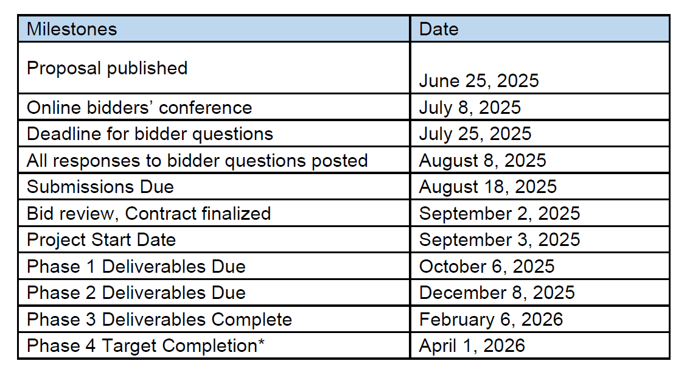
Proposed Timeline
Proposers are encouraged to submit their own Project Timeline, preferably compressed.

Slide 9
How to propose
Please ensure your proposals include all the information requested in RFP Section IV, 4.2 and all of the required documents and other elements identified in RFP Section VII. Note requirement for an authorized signature.
Please monitor RAMPLA for updates to the RFP and for new Q&As.
Submit proposals in hard copy and electronic format (USB drives) to:
Office of the Chief Legislative Analyst
200 North Spring Street, Room 270 (Mail Stop #136)
Los Angeles, California 90015
ATTN: Louisa Lund
Proposals must be received by 5PM PT on August 18, 2025.

Slide 10
Evaluation Process
Threshold review for completeness and compliance. The City may, at its sole discretion, deem a proposer non-responsive or request additional documents if the proposer fails to provide all required documentation and copies.
A selection panel will evaluate all complete proposals.
All proposers will be notified in writing once a selection has been made.

Slide 11
Contracting
The City’s Standard Provisions for City Contracts are attached to the RFP. The CLA’s office does not have authority to waive any of these provisions. Any requested deviations must be identified in the proposal. The City Attorney must approve all contracts.
Upon award, the City will work with the selected contractor to finalize a contract based on the standard provisions and the Contractors’ proposed scope, budget, and timeline. Time will be of the essence in completing this contract so that work can begin.
If a contract cannot be reached in a timely manner, the City reserves the right to negotiate with the next-ranked bidder.
Insurance requirements are detailed in RAMPLA. Contractors will be required to demonstrate required insurance coverage before beginning work.

Slide 12
How to submit questions/find answers during the RFP process
Questions asked today will be posted in written form, along with answers, to RAMPLA.
After today, questions should be submitted to: louisa.lund@lacity.org. Please reference the RFP in the subject line.
Responses will be posted on RAMPLA.
The deadline for questions is July 25, 2025.
All answers will be posted by August 8, 2025.

Slide 13
Working with RAMPLA
RAMPLA is the procurement portal for the City of Los Angeles, and it is where all information about this procurement will be posted.
Access RAMPLA at www.rampla.org and search for Opportunity # 222183.
You will need to register to get full access to the RFP materials.
For help with RAMPLA, go to their support page: https://www.rampla.org/s/support

Slide 14
Questions?
Please post any questions in the chat.
Thank you for your interest in this RFP!

